Slide 1
Packaging as an experience
May 2022

Slide 2
What do we mean when we talk about the kids & families sector?
MILLENNIALS
CENTENNIALS
ALPHA
Making up 23% of the world population, they are the largest group of adults, and the new generation of parents. They are a hyperconnected, entrepreneurial and committed generation.
They are 25% of the world population, and together with millennials they already account for 35% of the world’s income. They are digital natives, impatient, open to diversity and have a collective conscience.
It is estimated that every week 2.5 million Alpha kids are born in the world. They influence 40-60% of family purchasing decisions, and will perform jobs that we can't even imagine.

Slide 3
Why are we conducting this study?
A
Generational insights
Packaging as an experience
B
Industry Challenges
Collaboration between value chains
D
C
Sustainability

Slide 4
Identify relevant trends in the main children's & family categories
The objective of this presentation is to share insights and perspectives on the main innovation trends that shape the future of the packaging industry in the main children's & family categories.
We have analysed the global innovation drivers that affect the design, manufacturing and creation of consumer experiences to identify the most relevant macrotrends.

Slide 5
Relevant macrotrends
Based on a global analysis of the most relevant macrotrends, we have identified the three areas with the greatest impact for the packaging sector for Kids & Families audiences:
PEACE OF MIND Families need to feel confident and secure in parenting, with solutions tailored to their lifestyle and values.
SUSTAINABILITY
New consumer values mean that companies must be involved in environmental protection.
FUN!
Kids & Families are looking to share valuable experiences that surprise and entertain.
https://exploreloop.com/purpose

Slide 6
Index of identified trends
FUN!
Insights: Generation Z Kids
PEACE OF MIND
Insights: Millennial families
SUSTAINABILITY
Insights: Eco
1. Storytelling and entertainment
2. Augmented Reality
3. Part of the experience
4. Play & learn
5. Kidults!
6. Nostalgia
7. Unboxing phenomenon
8. Surprise factor
9. Characterisation
10. Beyond licensing
11. Limited Editions
12. Customisation 1
13. Family style
Millennial families
14. Support the parenting process15. On-the-go
16. Safety
17. Transparency
18. Inclusivity
19. Reduction of plastics
20. Improve recyclability
21. Reuse
22. Collaboration in the value chain
23. Retail Transformation
24. Servitization

Slide 7
FUN!
In response to the demands of today's littlest consumers, new packaging proposals are emerging that are able to create a hybrid between physical and digital while constantly surprise and entertain by using creativity, design and value collaborations.
Can we use packaging to create interactive experiences that are full of play and fun and encourage enjoying and learning together?

Slide 8
Insights: Generation Z Kids
Generation Z (born in the late 90s) has grown up in a fully digital environment, but with economic uncertainty, a climate emergency and social changes and innovations that are taking place at great speed.
They represent a new consumer profile with new values, very clear ideas and great influence on family purchases. Authenticity, transparency and sustainability are priority values.
They are looking for digital and social experiences to share. Their influence shapes the attitudes of the Alpha generation (born starting in 2010), with the pandemic as a key period of their early years.

Slide 9
How can we appeal to the values and demands of these new generations?

Slide 10
Play & learn
Brands invite you to play and learn together as a family through tangible and digital gamification proposals that generate new memorable and shared experiences and add more value.
“Let's play with the box" – IKEA Toybox app Ikea opted for AR through an app to make the most of the cardboard boxes in which its products are delivered. + info / + info

Slide 11
How can we invite families to play and learn together using packaging?

Slide 12
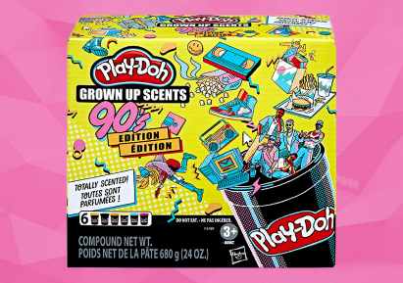
Kidults!
“Kidults" are adults willing to continue consuming products and brands for which they feel an emotional connection. This creates an opportunity within the children's categories to develop new value propositions aimed at the adult demographic.
Adult Plasticine – PlayDoh Grown Up Scents This product geared for adults highlights the benefits of mindfulness, with references to popular culture and packaging that evokes the nostalgia of the 90s and replaces the traditional yellow boats with black boats. + info

Slide 13
Can we offer new value propositions and packaging geared for adults?

Slide 14
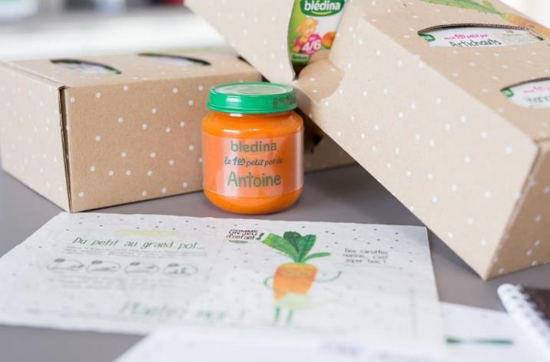
Customisation
Consumers value being treated as unique individuals with products just for them. Customisation options applied to packaging offer personalized experiences, which promote the product in a way that sets it apart.
My first customised puree– Blédina "Ma 1ère petite box" Blédina offers a pack to start the baby in solid feeding with their first carrot puree in a personalised bottle with their name. A way to turn that big day into an even more special moment. + info

Slide 15
Can we connect more with the consumer through personalisation in packaging?

Slide 16
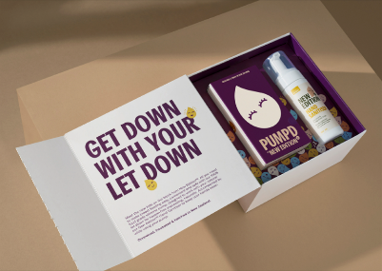
Family style
Brands adapt to the tastes of today's parents, following lifestyle trends and fashions to adapt products, branding, communication and packaging that get their attention with careful and unique design proposals.
Breastfeeding with humour and design - Pumpd The “breast pump" brand Pumpd, has developed an image with illustrations, strong colours and funny messages in communication and packaging, a different approach to breastfeeding for today's mothers. + info

Slide 17
Can we offer attractive solutions with designs that suit their lifestyles?

Slide 18
PEACE OF MIND
The new solutions for today's families must respond to their needs and values and provide solutions for their concerns, with products that accompany them in their on-the-go lives, with information, security, transparency and inclusivity.
Can we use packaging to guarantee families' peace of mind and ensure they have all they need to feel secure and confident as they raise their children?

Slide 19
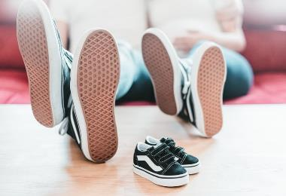
Insights:
Millennial families
The arrival of Millennials to parenthood has been accompanied by new attitudes and priorities that are transforming family structures and dynamics in an unstoppable way, creating new demands for products and services.
With smartphones in hand, their experiences of parenthood are more social, shared and exposed than ever.
Mothers work and fathers are more involved and prioritise family time.
They are navigating great social, political and economic changes and a context full of uncertainty. They worry about their family's safety and they like to plan, to feel that they are in control and have peace of mind.

Slide 20
How can we appeal to parents' new values and solve their concerns?

Slide 21
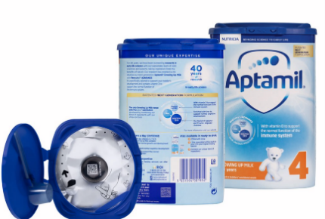
Safety
The new functionalities of smart packaging offer the safety guarantees that families need in key areas such as food, hygiene or health.
"Track & connect" with all the guarantees - Aptamil Danone implements in its infant milks a digital security solution with two QR codes that allow parents to verify quality and authenticity, in addition to connecting them with attention and support services. + info

Slide 22
How can we offer guarantees of safety and peace of mind through packaging?

Slide 23
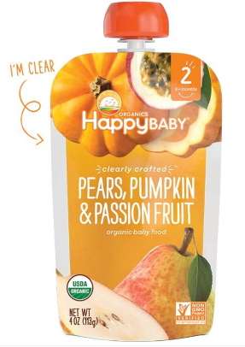
Transparency
Consumers demand transparency and honesty in products, ingredients and manufacturing processes. Packaging is reinvented to include clear and detailed information and even designs that are literally transparent.
A literally transparent package – Clearly Crafted. Happy Family makes a difference through completely transparent packaging for its collection of organic purees, which convey all the key information and earn consumers' trust... + info

Slide 24
Can we communicate transparently without giving up appealing packaging?

Slide 25
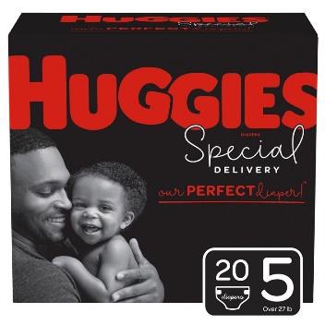
Inclusivity
The inclusive design of products and services ensures their attractiveness and accessibility for all consumers, regardless of gender, circumstances or abilities, in a social context that recognises and values diversity more than ever.
New roles and family models – Huggies Special Delivery The new range of nappies made with plant-based fibres has packaging that is also revolutionary: a premium look in black and with images of fathers that celebrate the importance of their role in today's families. + info

Slide 26
How can we guarantee and promote inclusivity through packaging?

Slide 27
SUSTAINABILITY
The commitment to sustainability goes beyond the reduction of plastics, with the development and application of new sustainable and more recyclable materials, designs that simplify and propose new uses, generating less waste while creating opportunities to offer new experiences, more differentiation and more value to families.
Can we simplify or rethink packaging design to generate efficiencies throughout the chain able to deliver more value for the consumer?

Slide 28
Insights: Eco Awareness
Millennials and their children already consider the fight against climate change to be one of the most important challenges facing humanity. They take into account the environment and prefer brands that benefit the environment, avoiding those that destroy the planet.
Today's parents strongly believe in the importance of environmental sustainability in their consumption decisions and actively try to share these values with their children
The environment is one of the most worrying problems for children, which is why they demand transparency and action from companies. Companies' involvement will be key to fighting climate change without losing consumer loyalty.

Slide 29
How can we put sustainability at the heart of our packaging strategy?

Slide 30
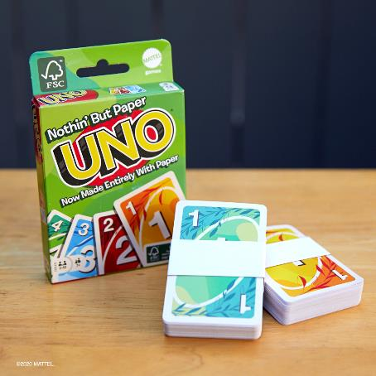
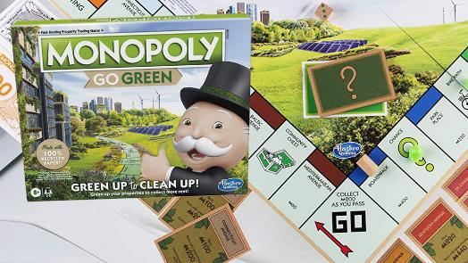
Plastics reduction
Children's categories lead the way in reducing the use of all types of plastic in packaging and single-use products, eliminating it as much as possible from designs and looking for viable alternatives from other materials.
Toys become "Green" – Lego, Uno, Hasbro Toy manufacturers who are reviewing and redesigning their packaging and even the products themselves to reduce the need for plastic and the creation of hard-to-recycle waste. + info / + info / + info

Slide 31
Are there opportunities to reduce or replace plastics by offering the user added value?

Slide 32
Improve recyclability
Companies must work to enhance the recyclability of packaging, without renouncing the guarantees and functionalities developed thanks to packaging technologies in recent decades.
Redesign for recycling - Nestlé redesigns its children's food pouches with a single material to facilitate recycling, a first step in its commitment to ensure that all its packaging will be recyclable or reusable by 2025. + info

Slide 33
How can we improve or facilitate the recycling of our packaging?

Slide 34
Collaboration in the value chain
Reducing waste and improving recycling requires involvement and collaboration throughout the entire value chain: from manufacturing, to logistics, to retail exposure and final transport in e-commerce.
E-commerce with less waste and no frustrations - Amazon frustration-free packaging Amazon collaborates with manufacturers to adapt and optimise their packaging for the e-commerce channel, offering them economic incentives to participate. + info

Slide 35
Can we collaborate throughout the value chain to solve sustainability challenges?

Slide 36
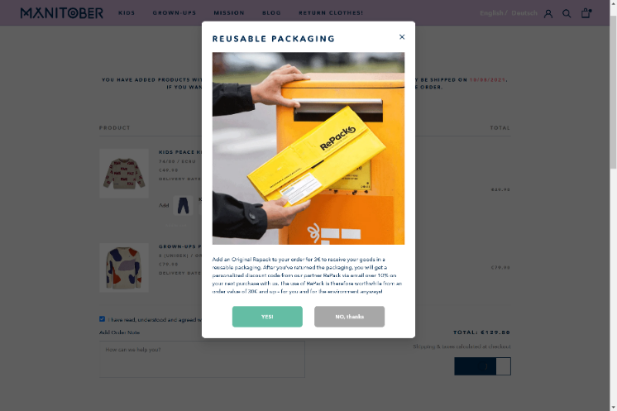
Retail Transformation
New habits and new channels drive opportunities to develop specific solutions. Opportunities arise to retain customers online with functional and unique packaging designs that offer the customer added value.
A returnable ecommerce packaging service - Manitober and RePackA returnable packaging service used by companies such as children's clothing brand Manitober, the product is delivered in reusable packaging that is recovered and cleaned for re-distribution to retailer. + info / + info

Slide 37
How can we optimise packaging for the retail of the future?

Slide 38
Servitization
In the packaging sector, servitization translates into process efficiency, digital transformation, data analysis and connectivity, responding to emerging needs.
A returnable packaging platform - Loop A coalition of leading brands has developed a zero-waste platform from reusable packaging. Now available in the USA and France, with several brands of food and child care products. + info

Slide 39
How can we respond to the need for sustainability with added services?

Slide 40
Relevant macrotrends, relevant questions
PEACE OF MIND
Can we use packaging to guarantee families' peace of mind and ensure they have all they need to feel secure and confident as they raise their children?
SUSTAINABILITY
Can we simplify or rethink packaging design to generate efficiencies throughout the chain able to deliver more value for the consumer?
FUN!
Can we use packaging to create interactive experiences that are full of play and fun and encourage enjoying and learning together?

Slide 41
To receive the full report regarding packaging trends in kids; categories or in packaging trends all-sectors, you can contact:
Xavier Lesauvage
xavier.lesauvage@sdli.es
www.sdli.es
Alex Brossa
abrossa@packagingcluster.com
www.packagingcluster.com

Slide 42
Thank you!
February 2022

